Slide 1

AI-Enhanced Educational Support System for Children with Dyslexia Leveraging AI to Overcome Dyslexia Challenges
Presented by:
Suhaib Ahmed (160721747016)
Danish Ahmed (160721747008)
Syed Usayd (160721747046)
Under the guidiance of:

Slide 2

CONTENT
Abstract
Introduction to Dyslexia
Project Objectives
Key Features of the AI System
Literature Survey
System Architecture
Modules Overview
Technology Stack
Benefits & Impact
Challenges & Future Work
Conclusion
References

Slide 3

Abstract
AI-Enhanced Educational Support System for Children with Dyslexia
Dyslexia is a common learning disability that affects a child's ability to read, write, and comprehend text. Traditional educational methods often fall short in providing adequate support to dyslexic learners, leaving them struggling in academic settings.
This project aims to develop an AI-powered educational support system specifically designed for children with dyslexia. It integrates machine learning and natural language processing techniques across multiple modules, including Reading Support (Text-to-Speech and Speech-to-Text), Writing Assistance (spelling and grammar correction), and Memory & Comprehension (text simplification and summarization).
The system also features a parental dashboard and teacher collaboration tools for real-time tracking, along with gamified exercises to enhance engagement. By providing a personalized learning environment, this system will help dyslexic children overcome challenges and improve their literacy skills.

Slide 4
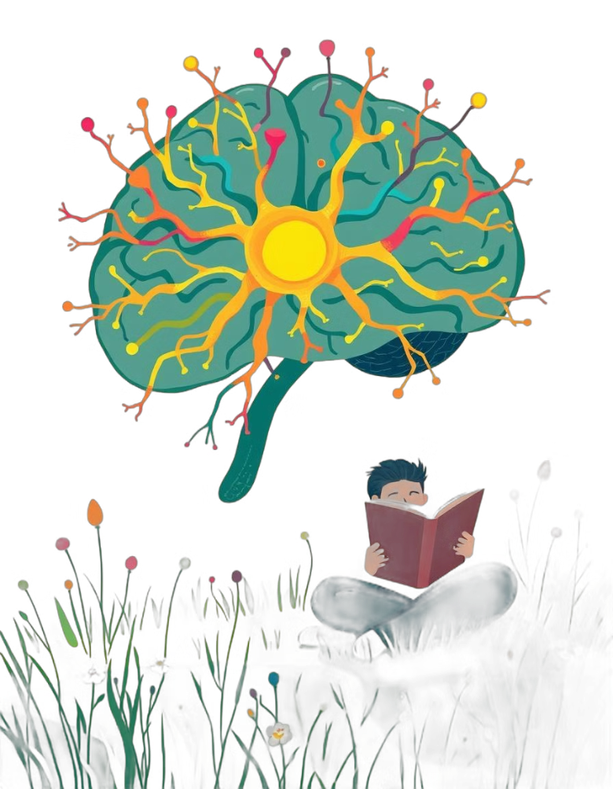
INTRODUCTION TO DYSLEXIA
Dyslexia is a neurological learning disability that affects reading, writing, and language processing.
It impacts approximately 5-10% of the global population.
Dyslexic learners often face difficulties in phonological awareness, spelling, and comprehension, which can lead to struggles in academic performance.
Traditional teaching methods may not cater to the unique learning patterns of dyslexic students, necessitating innovative educational solutions.
The increasing demand for technology-driven approaches to assist dyslexic learners. Leveraging AI and machine learning to create tailored educational support systems and providing dyslexic students with tools that adapt to their learning pace and style.

Slide 5

PROJECT OBJECTIVE
Develop an AI-powered educational support system tailored for children with dyslexia.
Provide personalized, adaptive learning experiences to address individual challenges in reading, writing, and comprehension.
Integrate multi-sensory tools (Text-to-Speech, Speech-to-Text, etc.) to enhance learning outcomes.
Enable real-time progress tracking through a parental dashboard and teacher collaboration features.
Utilize gamification to make the learning process engaging and interactive for children.

Slide 6

Key Components and Research Findings
AI in Education
Machine Learning for Writing Support
Gamified Learning
Recent studies have demonstrated the effectiveness of AI-driven tools like Text-to-Speech (TTS) and Speech-to-Text (STT) systems in helping dyslexic students overcome reading challenges. AI-based writing assistants using Natural Language Processing (NLP) have also proven valuable for improving grammar and spelling in students with dyslexia.
Gamification in educational tools has proven highly effective for engaging children with learning disabilities. Games that adapt to the user's progress have been shown to significantly improve learning outcomes in dyslexic children. Reinforcement learning algorithms can dynamically adjust the difficulty of exercises based on the child's performance.
Grammar correction tools powered by machine learning models, such as transformer-based architectures (BERT, GPT), can automatically detect and correct common spelling and grammar mistakes. Targeted interventions using these tools can help dyslexic students write more fluently and accurately.
Memory and Comprehension Support through NLP:
Gamified Learning for Dyslexic Children:
Progress Tracking and Parental Involvement:
NLP models have also been employed for text simplification and summarization to aid children in better understanding complex texts.
Gamification in educational tools has proven highly effective for engaging children with learning disabilities. Games that adapt to the user's progress have been shown to significantly improve learning outcomes in dyslexic children (Deterding et al., 2011).
Effective learning for dyslexic children requires continuous assessment and adaptation. Predictive analytics, a branch of machine learning, can also forecast future learning difficulties based on historical performance data, allowing for proactive measures.

Slide 7

LITERATURE SURVEY
Dyslexia and Educational Challenges:
Affects 5-10% of the population, impacting reading, writing, and comprehension (Shaywitz et al., 2008).
Traditional methods often fail to address these challenges.
Use of AI in Education:
AI tools like Text-to-Speech (TTS) and Speech-to-Text (STT) enhance reading support (Truong et al., 2020).
NLP-based writing assistants improve spelling and grammar (Berninger et al., 2013).
Machine Learning in Grammar and Writing:
Transformer models like BERT and GPT significantly improve grammar correction (Bryant & Nunes, 2012).
Memory & Comprehension Support:
NLP models for text simplification enhance readability (Siddharthan, 2014).
Gamified Learning:
Adaptive games enhance engagement and learning outcomes (Deterding et al., 2011).
Progress Tracking and Parental Involvement:
AI dashboards support continuous progress tracking and intervention (Griffiths, 2015).

Slide 8

SYSTEM ARCHTECTURE
The system is built using a modular approach with interconnected components:
Data Input: Collects student responses and interactions.
AI Engine: Uses Machine Learning models for TTS, STT, grammar correction, and adaptive learning.
User Interface: Provides interactive modules for reading, writing, and comprehension support.
Dashboard: Real-time analytics for parents and teachers.
The architecture supports scalability and integration with existing educational platforms.

Slide 9

CONCLUSION
The literature indicates that AI, when applied thoughtfully, can provide dyslexic students with personalized learning experiences. Existing technologies like TTS, STT, and NLP-based grammar correction have been shown to improve learning outcomes, but their full potential is realized when combined into a comprehensive system. This project aims to bridge this gap by integrating multiple AI-powered modules into a unified platform, enabling dyslexic children to enhance their educational experience while building confidence and independence.

Slide 10

REFERENCES
References:
Berninger, V. W., & May, M. O. (2013). Dyslexia and Writing: Evidence-based Interventions and Insights. Journal of Learning Disabilities.
Bryant, P., & Nunes, T. (2012). The Impact of Spelling on Dyslexic Learners. Dyslexia Research Journal.
Deterding, S., Dixon, D., Khaled, R., & Nacke, L. (2011). From Game Design Elements to Gamefulness: Defining "Gamification". Proceedings of the 15th International Academic MindTrek Conference.
Gala, N., Grabar, N., & Zock, M. (2020). Automatic Text Simplification: A Survey. Computational Linguistics.
Griffiths, A. (2015). The Role of Parental Involvement in Dyslexic Children’s Learning. Dyslexia Education Research.
Hadi, S., & Rahman, A. (2021). AI-Powered Tools for Dyslexia: A Survey of Technologies. Educational Technology & Society.
Shaywitz, S. E., & Shaywitz, B. A. (2008). Dyslexia (Specific Reading Disability). Biological Psychiatry.
Siddharthan, A. (2014). A Survey of Research on Text Simplification. International Journal of Computational Linguistics.
Truong, K., Weiss, M., & Koller, O. (2020). Speech Technologies for Dyslexia Support: Current Advances and Future Directions. IEEE Speech and Language Processing Journal.
Zhao, Y., & Vlachopoulos, D. (2019). Gamified Learning: Advances in Personalized Education. Educational Games and Technology Research.

